Slide 1

WING DESIGN – Calculation of Swf
AESP 415 – Aircraft Design Part I Basics
Lecture 15
MODULE
4
TOPIC 8
Dr. Wout De Backer
1000 Catawba St, Ste 120
wdbacker@cec.sc.edu

Slide 2
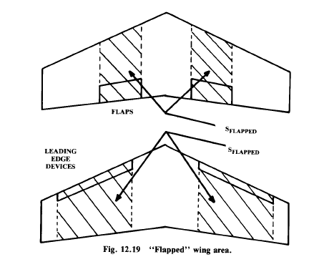
8.4 Evaluation of the Lift Curve for the Flapped Wing
S_{wf}/S : Ratio between reference wing flapped surface and reference wing surface
The LE flapped area S_{wf_LE} is generally larger than the TE flapped area S_{wf_TE}
The flapped area S_{wf} IS NOT the area of the flap!
You CANNOT have S_{wf} = S due to presence of the fuselage (& ailerons)!
Fuselage
Swf_TE
Swf_LE
Notes:
The area of the flap can be calculated by assuming that flaps have same taper ratio as the wing (quite common), knowing the value of c_{f}/c and deciding at what distance from the fuselage intersection to locate the flaps.

Slide 3
8.4 Evaluation of the Lift Curve for the Flapped Wing
Step 1: Determine the required flapped surface S_{wf} to meet the required ΔC_{Lmax}
Estimate the flap hinge angle on the base of the position of the support spar (the back spar) used to attach the flaps
clean
See values table next slide
flapped
α
Notes:
You can estimate the flap hinge angle value on the base of the position of the support spar (the back spar) used to attach the flaps.
Once a certain type of flaps has been selected and the required value for ΔC_{Lmax} has been estimated, the flapped surface can be estimated.
Rather than guessing a value of Swf/S, you can better solve the equation above computing the necessary Swf/S for a certain ΔC_{lmax} .
If the value of Swf/S result so large that you do not have space anymore for ailerons, then you can increase the chord length of the flap (if you are allowed) and/or change type of flaps.

Slide 4
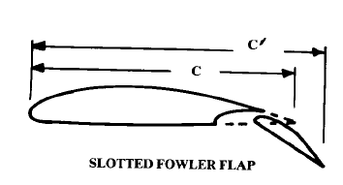

8.4 Evaluation of the Lift Curve for the Flapped Wing
High lift device | ΔC_{lmax} when full deployed
TE devices (flaps)
Plain and split | 0.9
slotted | 1.3
fowler | 1.3 c’/c
Double slotted | 1.6 c’/c
Triple slotted | 1.9 c’/c
LE devices
Fixed slot | 0.2
Leading edge flap | 0.3
Kruger flap | 0.3
Slat | 0.4 c’/c
Step 1: Determine the required flapped ΔC_{lmax}
Note: ΔC_{lmax} ≠ ΔC_{Lmax}
ΔC_{lmax} values in the order of 60-80% of those in the table should be used at take off, to account for the partial deployment of the devices
Notes:
The c’/c value is related to the assumed value of cf/c, the ratio between the length of the flap chord and the airfoil chord. See next slide for the exact relation.
When assuming a value for cf/c, you are somehow deciding also the position of the wing back spar (the spar where flaps are hinged).
Too high values of cf will force you to move the back spar too much forward. You will have to check if enough volume is available for the fuel tanks!
Without considering the reduction of torsion stiffness of the wingbox…

Slide 5
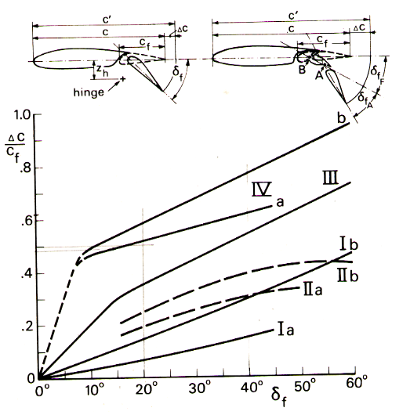
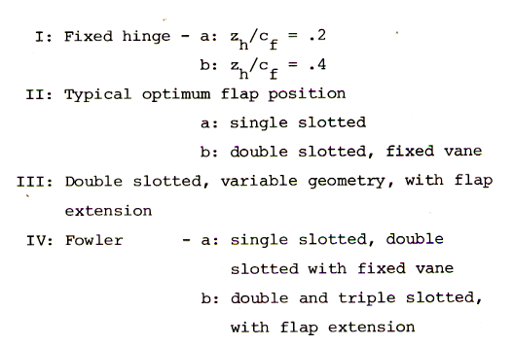
8.4 Evaluation of the Lift Curve for the Flapped Wing
c’/c is dependent on flap type and deflection:
To compute c’/c, you can use this graph
First assume a value of c_{f} (see note previous slide)
Then obtain Δc/ c_{f}, based on deflection angle δ_{f} Note that Δc/ c_{f} varies at take off and landing)
The flapped chord c’ is then:
c’= c + Δc

Slide 6
8.4 Evaluation of the Lift Curve for the Flapped Wing
Step 2: Determine the approximate variation of α_{0L} due to TE devices
Δα_{0L} can be assumed to be the same value for various TE devices
clean
= - 15 deg at landing
= - 10 deg at take off
flapped
α

Slide 7
8.4 Evaluation of the Lift Curve for the Flapped Wing
Step 3: Determine the slope of the flapped curve
For TE devices which do not increase the wing surface:
For TE devices which increase the wing surface: Where S’ is the increased wing surface by the extended flap (S’/S >1)
With*
clean
S’
flapped
Extracted flaps
S_{wf}
α
Notes:
To compute S’ you need to know the size of your flaps!
*If we assume for the flaps (or slats) the same taper ratio as the wing, by simple geometric considerations we can approximate: S’/S= 1+Swf/S(c’/c -1).
Concerning the curve part of the flapped lift curve (around the C_{lmax} values, hence in correspondence of the stall angle), for simplicity we can assume the same shape as for the clean wing!

Slide 8
8.4 Evaluation of the Lift Curve for the Flapped Wing
Step 4: Add the contribution of the LE devices
See step 1 and table to compute the LE devices contribution
consider the increase in lift-curve slope due to the extended wing surface if slats are used no other LE devices increase the wing surface), exactly as explained for the flaps at step 3
Generally Δα_{0L} associated to LE devices is neglected (only the TE devices are responsible of Δα0L )
clean
flapped
The LE flapped area S_{wf_LE} is generally larger than the TE flapped area S_{wf_TE}
α
Notes:
See step 1 and relative table to compute the LE devices contribution.
Also here you can consider the increase in lift-curve slope due to the extended wing surface if slats are used (no other LE devices increase the wing surface), exactly as explained for the flaps at step 3.
Generally Δα_{0L} associated to LE devices is neglected. As shown in figure above, only the TE devices are responsible of Δα_{0L .}
Note that since the effect of the TE/LE devices depends on their deflection angles, we will get different CL-alpha-flapped curves at take off and landing`.. Typically we have full deflection during landing and about half of these value during takeoff (see typical values indicated in previous slides) in order not to spoil the aerodynamic efficiency of the wing during take off when there are climb gradient requirements to be met.

Slide 9
8.4 High Lift Devices Calculation of the flapped wing surface S_{wf}
From the previous slides, we know that the flapped wing surface is defined as:
Now we know the % of the wing that is flapped, but how do we calculate the span wise flapped section l_{flaps}?
Fuselage diameter d
C_{f,root}
Fuselage
C_{f,tip}
C_{r}
C_{t}
l_{froot}
l_{flaps}
Swf_TE
b/2

Slide 10
8.4 High Lift Devices Calculation of the S_{wf}
Consider a half wing with root chord c_{r} , tip chord c_{t}, and span b:
At any point x along the half wing, the chord c_{x} , is defined as
Fuselage of diameter d
C_{x}
C_{r}
C_{t}
x
b/2

Slide 11
8.4 High Lift Devices Calculation of the S_{wf}
At any point x along the half wing, the chord c_{x} , is defined as:
For a flapped wing, with flaps starting at l_{f,root} and a flap span of l_{flaps}:
Fuselage diameter d
C_{f,root}
C_{f,tip}
C_{r}
C_{t}
l_{f,root}
l_{flaps}
b/2

Slide 12
8.4 High Lift Devices Calculation of the S_{wf}
The flapped wing surface for this half wing is then:
Substitution of C_{f,root} and C_{f,tip} from previous slide yields:
Fuselage diameter d
C_{f,root}
C_{f,tip}
C_{r}
C_{t}
l_{f,root}
l_{flaps}
b/2

Slide 13
8.4 High Lift Devices Calculation of the S_{wf}
Derivation:
Substitution

Slide 14
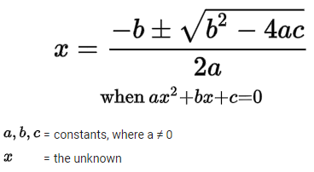
8.4 High Lift Devices Calculation of the S_{wf}
Derivation:
Solve for lflaps

Slide 15
8.4 High Lift Devices Calculation of the S_{wf}
The flapped wing surface for this half wing is then:
Solving for l_{flaps} yields:
Fuselage diameter d
C_{f,root}
C_{f,tip}
C_{r}
C_{t}
l_{f,root}
l_{flaps}
b/2

Slide 16
WING DESIGN
AESP 415 – Aircraft Design Part I Basics
Lecture 15
MODULE
4
TOPIC 8
Thank You!
Dr. Wout De Backer
1000 Catawba St, Ste 120
wdbacker@cec.sc.edu

